Slide 1
MIS – PS Keep Your Time

Slide 2
Content

Slide 3
Product Overview
João Martins

Slide 4
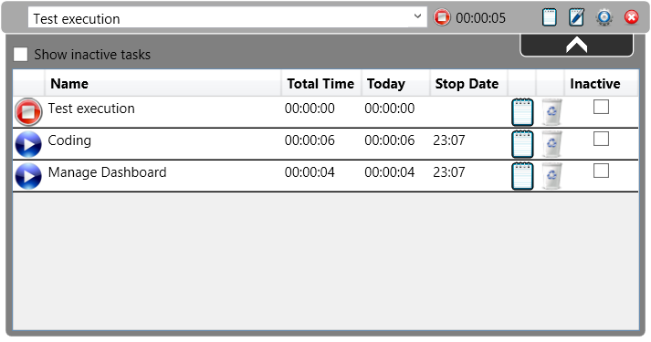
Product Overview

Slide 5
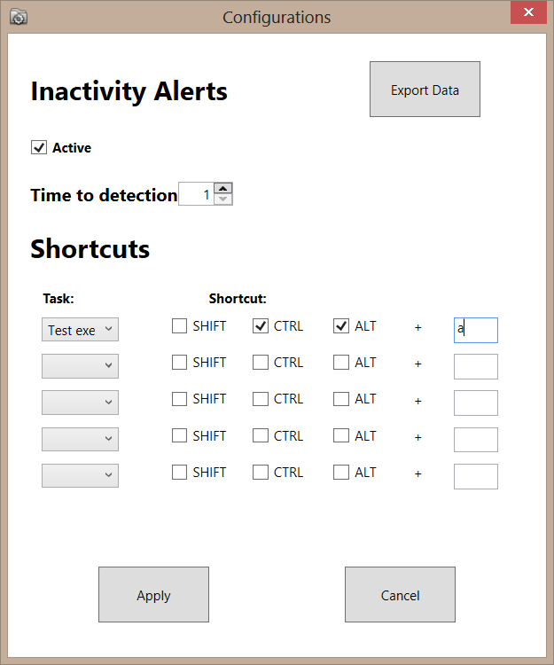
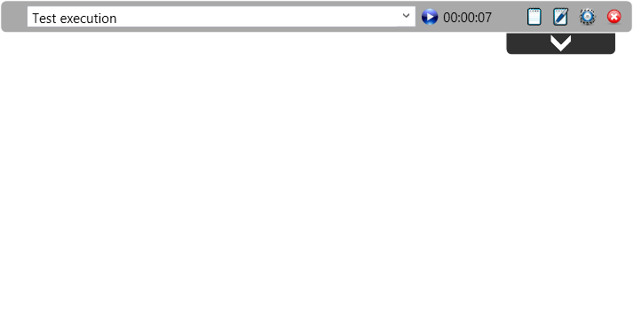
Product Overview

Slide 6
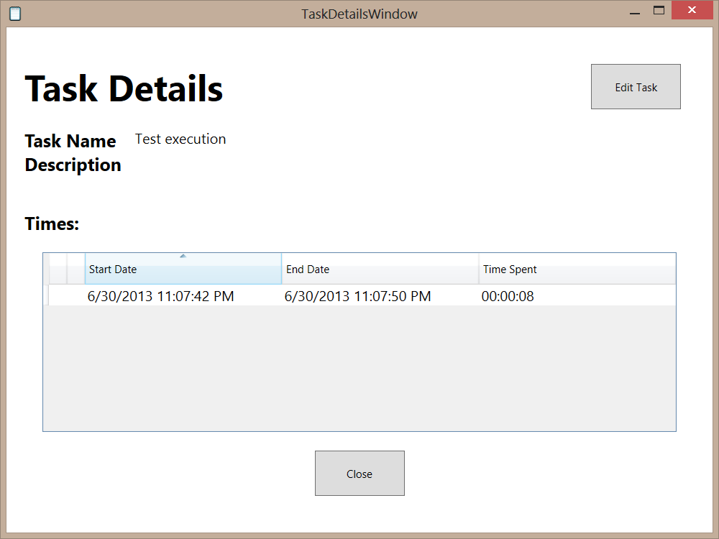
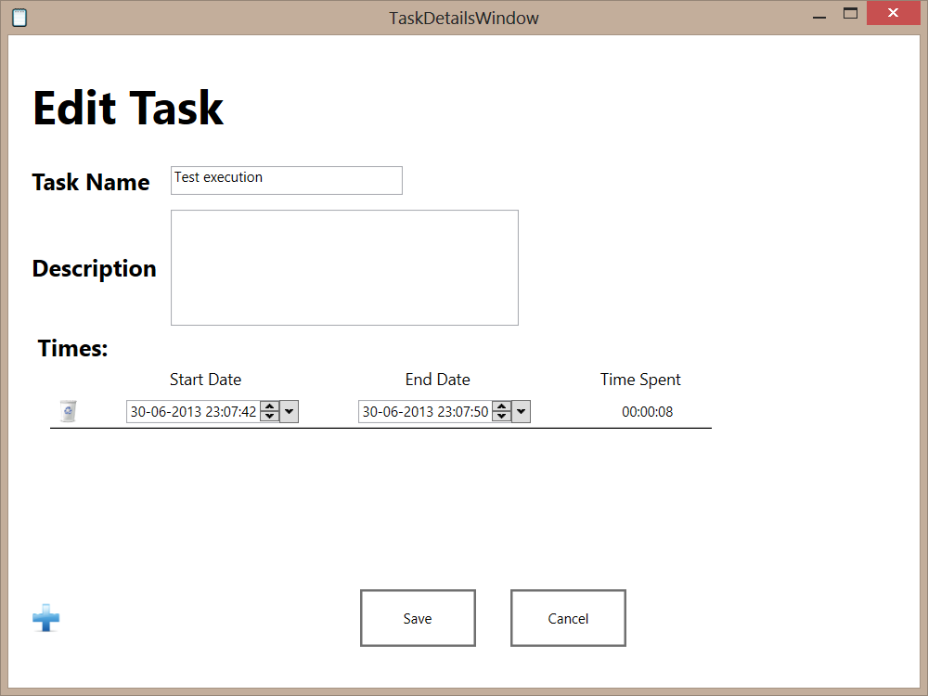
Product Overview

Slide 7
Project Managment
Filipe Brandão

Slide 9
Product
João Martins

Slide 11
Requirements
Number of Initial Requirements
66
Number of Delivered Requirements
64

Slide 12
Requirements
Requirements | Nº | Requirements Delivered | Requirements not Delivered
Functional | 53 | 51 | 2
Interface | 11 | 11 | 0
Performance | 2 | 2 | 0
Total | 66 | 64 | 2

Slide 13
Requirements conclusion
97% of the Requirements were delivered
Requirements not Delivered:
12CIT-003:ConfigureInactiveTime.Validate.False
1CT-004:Task.create.AutoComplete
Notes:
A tecnologia usada permite uma melhor validação contudo não permite mandar mensagem de erro porque a tecnologia resolve o erro sozinha
Funciona com o primeiro Caracter.Complicado de se fazer pois a tecnologia está optimizada para o primeiro caracter.

Slide 14
Document Managment
Mário Oliveira

Slide 16
Project Quality
Carla Machado

Slide 17
Processes and Process Analysis
Document Management Process
It was followed in the majority of documents although some unconformities were detected
Not following correctly the hierarchy for the different roles
The process lacked flexibility in choosing the persons for the different roles
Project Assessment and Control Process
Project and risk control weren’t very accurate
Process wasn’t always exactly followed
Problems with some of the used tools

Slide 18
Processes and Process Analysis
Project Planning Process
Plan was updated
Redefinition of some concepts - milestones
Requirements Analysis Process
Major unconformity
changes were made that didn´t follow the change requirements process and documentation wasn’t updated

Slide 19
Processes and Process Analysis
Review Process
Major unconformity associated with the walkthrough
The process wasn´t followed and measures weren’t recorded
Verification & Validation Process
Doesn’t mention ad-hoc testing
How to report defects not associated with tests
What to do in cases of reopen
Test plan wasn’t concluded

Slide 20
Processes and Process Analysis
Common issues in following the processes
Process measures weren’t always recorded or updated timely
The processes weren’t always exactly followed as defined
Some processes were overcomplicated for the team and project needs

Slide 21
Quality Activities
Reviews
Inspections
Walkthrough
Desk checks
Quality verifications
Processes were followed
Testing
Unit testing
Acceptance and system testing

Slide 22
Quality Cost
Task | Time
Reviews | 46
Quality verifications | 2
Test Planning | 48
Test Execution | 7.25

Slide 23
Quality Perception

Slide 24
Architecture
Rui Ganhoto

Slide 26
Risk Management
João Girão

Slide 27
Risk Management - Timeline
Risks Identification:
Lack of knowledge on technology;
Project Plan is over budget
Problem Identification
08/04/2013
KOM
03/06/2013
Acceptance
Risk meeting
Risk meeting
Risk Identifications
Risk Identifications
Risk Minimization
(Lack of knowledge on technology)
Mitigation Plan
(task plan for final week)
REESTIMATION
(Project Plan is over budget)
Risks Number: 2

Slide 28
Risk Management
1º - Lack of knowledge on technology:
Probability: 3
Impact: 3
Team Member: João Girão, Mário Oliveira, David Silva, João Martins, Carla Machado and Filipe Brandão
Avoidance: To reduce probability all interfaces must be created and managed by Rui Ganhoto.
Minimization: To reduce Impact Rui Ganhoto must give some formation to every team members.
Contingency: Negotiate interface with the client and avoid WPF, windows forms would be an easier option for static content.

Slide 29
Risk Management
2º - Project Plan is over budget
Probability: 3
Impact: 2
Team Member: Everyone
Resolved with the Reestimation
The project doesn’t end at the planned time (it’s a problem)
Mitigation Plan: redistribution the tasks

Slide 30
Product Demonstration
David João

Slide 32
Analysis and Conclusions
Team

Slide 33
Global

Slide 34
Carla Machado

Slide 35
David João

Slide 36
Filipe Brandão

Slide 37
João Girão

Slide 38
João Martins
Main Contributions:
Project plan process definition
Verification and Validation process
Test plan
Lessons Learned:
Teamwork is important
Communication is a must!

Slide 39
João Martins
Lessons Learned:
Test plan is not easy to make
When anything can go wrong, it will go wrong.
Participation in Team Results:
Application Quality (Test plan)
Do everything that it’s needed.

Slide 40
Mário Oliveira

Slide 41
Rui Ganhoto

